Slide 1
Introduction to Microcontrollers and Programming
Part I

Slide 2
Basic Electronics
Electricity is the movement of electrons. Electrons create charge, which we can harness to do work.
Voltage-We define voltage as the amount of potential energy between two points on a circuit. One point has more charge than another
Current-Current is a flow of electrical charge carriers, usually electrons or electron-deficient atoms. The common symbol for current is the uppercase letter I.
Power-In addition to voltage and current, there is another measure of free electron activity in a circuit: power. Electric power is the rate, per unit time, at which electrical energy is transferred by an electric circuit. The SI unit of power is the watt, one joule per second.

Slide 3
Common Components in Circuits
An electric circuit is like a pathway made of wires that electrons can flow through.
Some of the most common components in circuits are:
Wires, Cables, and Connectors
Batteries
Switches
Resistors
Capacitors
Inductors

Slide 4
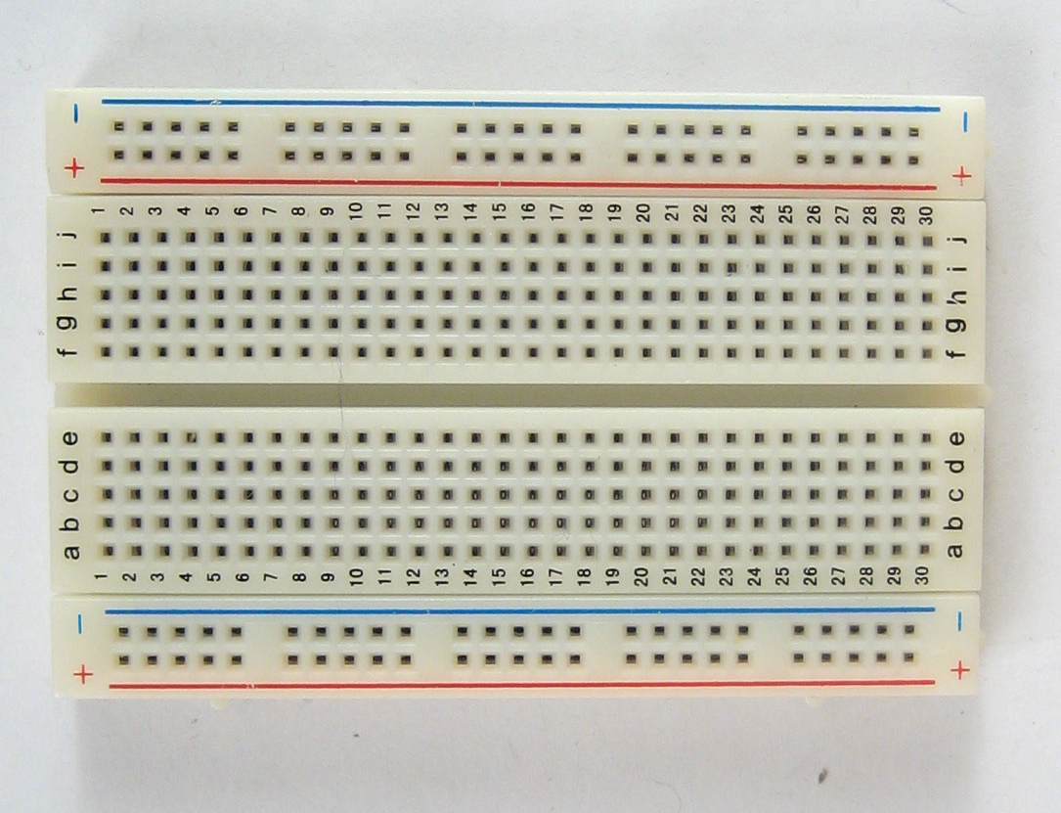
Building Your Own Circuits
In almost all IoT ‘thing’ design, you will need to construct your own circuit.
The Breadboard- Breadboards are one of the fundamental components when learning how to build circuits. These are great units for making temporary circuits and prototyping, and they require absolutely no soldering. Prototyping is the process of testing out an idea by creating a preliminary model from which other forms are developed or copied

Slide 5
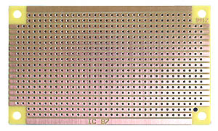
Protoboards -If you’re ready to finalize a breadboarded circuit, but not quite ready to create a printed circuit board, then your next step is protoboard
PCBs(Printed Circuit Boards)- PCB is an acronym for printed circuit board. It is a board that has lines and pads that connect various points together. There are traces that electrically connect the various connectors and components to each other. A PCB allows signals and power to be routed between physical devices. Solder is the metal that makes the electrical connections between the surface of the PCB and the electronic components. Being metal, solder also serves as a strong mechanical adhesive. Pad - a portion of exposed metal on the surface of a board to which a component is soldered.

Slide 6
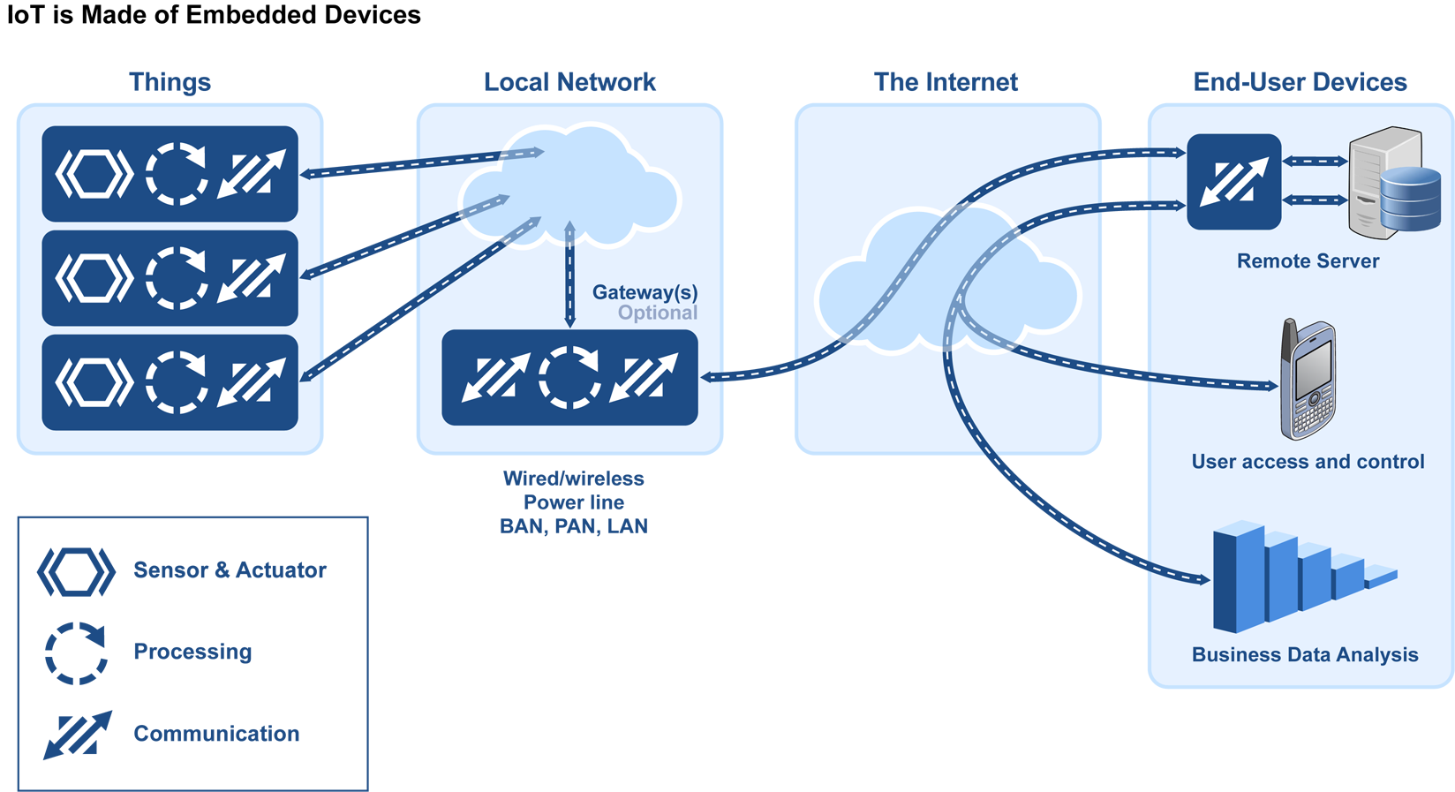
Major Components of an IoT Ecosystem
The following diagram depicts the major components that make up an IoT system

Slide 7
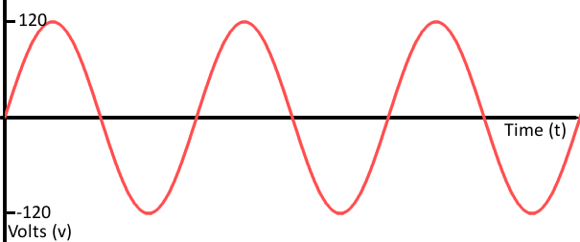
Analog Vs Digital Signals
An analog signal is a kind of signal that is continuously variable. While these signals may be limited to a range of maximum and minimum values, there are still an infinite number of possible values within that range. Video and audio transmissions are often transferred or recorded using analog signals.

Slide 8
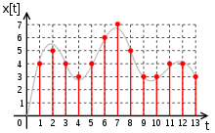
Digital Signals
A digital signal is a kind of signal that has a limited number of steps along its range. The number of values in the set can be anywhere between two and a-very-large-number-that’s-not-infinity.
Most communication between integrated circuits is digital. Interfaces like serial, I2C, and SPI all transmit data via a coded sequence of square waves.

Slide 9
Power Source-The smart object(things) need to be powered. Power requirements vary from application to application. Typically, smart objects are limited in power and are deployed for a very long time in places that are not easily accessible
Sensors- a sensor is a device that detects and responds to some type of input from the physical environment. There are many different types of sensors to measure all kinds of quantities.
Position -A position sensor measures the position of an object; the position of an object can either be in absolute terms or in relative terms e.g. inclinometer, proximity.
Occupancy and Motion Sensors- Occupancy sensors detect the presence of objects in a room, motion sensors detect movement. E.g. radar.
Velocity and acceleration Sensors- Detect velocity and acceleration e.g. accelerometer, gyroscope.
Force -e.g. force gauge, tactile sensor (sound sensor)
Pressure Sensor- Pressure sensors are related to force sensors; they measure force applied by liquids or gases e.g. barometer.
low Sensors- Detect the rate of fluid flow e.g. water meter.
Acoustic – Measure sound levels and convert that information into digital or analog signals e.g. microphone
Humidity Sensors- Detect the amount of water vapor in the air or a mass e.g. hygrometer, soil moisture sensor.
Light- detect the presence of light e.g. infrared sensor, photodetector.
Radiation Sensors- detect radiation in the environment. e.g. neutron detector.
Temperature Sensor- Measure the amount of heat or cold present in the environment. e.g. thermometer.
Chemical Sensor-measure the concentration of chemicals in a system. e.g. smoke detector.
Biosensors- detect various biological elements such as organisms, tissues, cells, enzymes, antibodies and nucleic acid

Slide 10
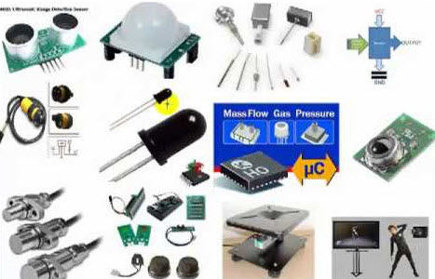

Slide 11
Processing Unit
This is the part of the thing responsible for acquiring data, processing and analyzing sensing information received by the sensors, coordinating control signals to any actuators and controlling a variety of functions on the smart objects, including the communication and power systems
A microcontroller is like a small computer on a single IC. It contains a processor core, ROM, RAM and I/O pins dedicated to perform various tasks. Microcontrollers are generally used in projects and applications that require direct control of user. Some examples of popular microcontrollers are 8051, AVR, PIC series of microcontrollers.

Slide 12
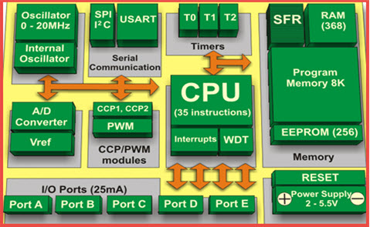
Major Components of Microcontrollers
A PIC microcontroller architecture is shown below:

Slide 13
Major Components of Microcontrollers
CPU – Microcontrollers brain is named as CPU. CPU is the device which is employed to fetch data, decode it and at the end complete the assigned task successfully
Memory – In a microcontroller memory chip works same as microprocessor. Memory chip stores all programs & data
Input/output ports – I/O ports are basically employed to interface or drive different appliances such as- printers, LCD’s, LED’s, etc.
Serial Ports – These ports give serial interfaces amid microcontroller & various other peripherals such as parallel port.
Timers – A microcontroller may be in-built with one or more timer or counters. The timers & counters control all counting & timing operations within a microcontroller
ADC (Analog to digital converter)

Slide 14
How Is a Microcontroller Different from A Microprocessor?
Microprocessor has only a CPU inside them in one or few Integrated Circuits. Unlike microcontrollers it does not have RAM, ROM and other peripherals. They are dependent on external circuits of peripherals to work. Microprocessors are not made for specific task but they are required where tasks are complex and tricky like development of software’s, games and other applications that require high memory and where input and output are not defined. It may be called heart of a computer system. Some examples of microprocessor are Pentium, I3, and I5 etc.

Slide 15
AVR Microcontrollers
AVR also known as Advanced Virtual RISC, is a customized Harvard architecture 8-bit RISC solitary chip micro-controller. AVR microcontrollers find many applications as embedded systems; they are also used in the Arduino line of open source board designs.

Slide 16
System-On-Chips
In between the low-end microcontroller and a full-blown PC sits the SoC. Like the microcontroller, these SoCs combine a processor and a number of peripherals onto a single chip but usually have more capabilities. The processors usually range from a few hundred megahertz, nudging into the gigahertz for top end solutions and include RAM measure in megabytes rather than kilobytes. Storage for SoC modules tends not to be included on the chip, with SD cards being a popular solution.

Slide 17
Interfacing
Embedded electronics is all about interlinking circuits (processors or other integrated circuits) to create a symbiotic system. In order for those individual circuits to swap their information, they must share a common communication protocol. Hundreds of communication protocols have been defined to achieve this data exchange, and, in general, each can be separated into one of two categories: parallel or serial.

Slide 18
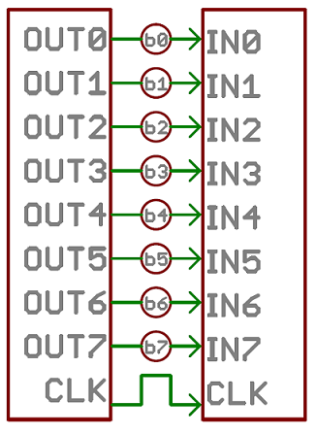
Parallel vs. Serial
Parallel interfaces transfer multiple bits at the same time. They usually require buses of data - transmitting across eight, sixteen, or more wires. Data is transferred in huge, crashing waves of 1’s and 0’s.

Slide 19
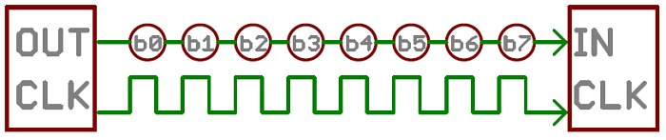
Parallel vs. Serial
Serial interfaces stream their data, one single bit at a time. These interfaces can operate on as little as one wire, usually never more than four.

Slide 20
Synchronous Vs Asynchronous Serial Communication
Asynchronous means that data is transferred without support from an external clock signal. This transmission method is perfect for minimizing the required wires and I/O pins, but it does mean we need to put some extra effort into reliably transferring and receiving data. UART is the most common form of asynchronous transfers.

Slide 21
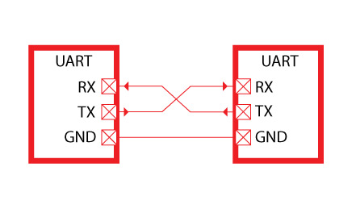
UART
UART stands for Universal Asynchronous Receiver/Transmitter and is really just a fancy way of referring to a serial port. It is really easy to understand as it only requires two lines: a transmission line (TX) and a receiving line (RX).

Slide 22
Synchronous
A synchronous serial interface always pairs its data line(s) with a clock signal, so all devices on a synchronous serial bus share a common clock. This makes for a more straightforward, often faster serial transfer, but it also requires at least one extra wire between communicating devices. Examples of synchronous interfaces include SPI, and I2C.

Slide 23
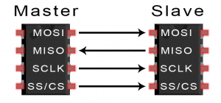
SPI
SPI stands for Serial Peripheral Interface. SPI is a common communication protocol used by many different devices. For example, SD card modules, RFID card reader modules, and 2.4 GHz wireless transmitter/receivers all use SPI to communicate with microcontrollers.
MOSI (Master Output/Slave Input) – Line for the master to send data to the slave.
MISO (Master Input/Slave Output) – Line for the slave to send data to the master.
SCLK (Clock) – Line for the clock signal.
SS/CS (Slave Select/Chip Select) – Line for the master to select which slave to send data to.

Slide 24
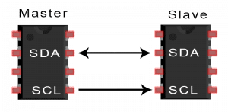
I2C
I2C stands for Inter-Integrated Circuit and is pronounced “I squared C”, “I two C” or “I-I-C”. I2C is a protocol that allows one device to exchange data with one or more connected devices through the use of a single data line and clock signal
Like UART communication, I2C only uses two wires to transmit data between devices:
SDA (Serial Data) – The line for the master and slave to send and receive data.
SCL (Serial Clock) – The line that carries the clock signal.

Slide 25
ARDUINO
Arduino is an open-source electronics platform based on easy-to-use hardware and software. Most Arduino boards are based on AVR microcontrollers. Arduino boards are able to read inputs - light on a sensor, a finger on a button, or a Twitter message - and turn it into an output - activating a motor, turning on an LED, publishing something online. You can tell your board what to do by sending a set of instructions to the microcontroller on the board. To do so you use the Arduino programming language , and the Arduino Software (IDE).

Slide 26
Advantages of Arduino
Inexpensive - Arduino boards are relatively inexpensive compared to other microcontroller platforms.
Cross-platform - The Arduino Software (IDE) runs on Windows, Macintosh OSX, and Linux operating systems. Most microcontroller systems are limited to Windows.
Simple, clear programming environment - The Arduino Software (IDE) is easy-to-use for beginners, yet flexible enough for advanced users to take advantage of as well..
Open source and extensible software - The Arduino software is published as open source tools, available for extension by experienced programmers..
Open source and extensible hardware - The plans of the Arduino boards are published under a Creative Commons license, so experienced circuit designers can make their own version of the module, extending it and improving it. Even relatively inexperienced users can build the breadboard version of the module in order to understand how it works and save money.

Slide 27
Arduino IDE
An integrated development environment (IDE) is a software suite that consolidates the basic tools developers need to write and test software. Typically, an IDE contains a code editor, a compiler or interpreter and a debugger that the developer accesses through a single graphical user interface (GUI). An IDE may be a standalone application, or it may be included as part of one or more existing and compatible applications.
Arduino provides an easy to use IDE to program Arduino and Arduino compatible boards.

Slide 28
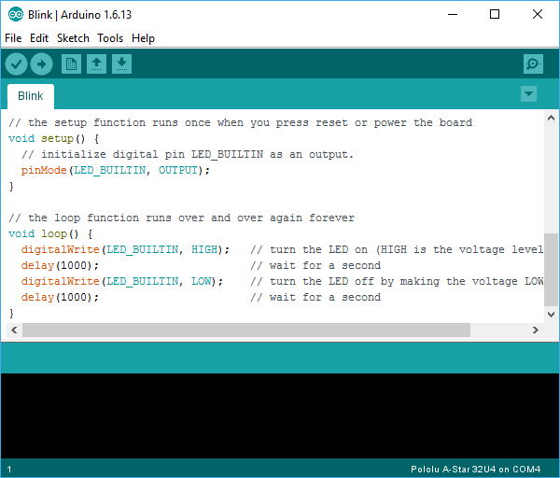

Slide 29
Arduino Libraries
The Arduino environment can be extended through the use of libraries, just like most programming platforms. Libraries provide extra functionality for use in sketches, e.g. working with hardware or manipulating data. In programming, a library is a collection of precompiled routines that a program can use. The routines, sometimes called modules, are stored in object format. Libraries are particularly useful for storing frequently used routines because you do not need to explicitly link them to every program that uses them.
Standard Libraries
EEPROM- reading and writing to "permanent" storage
Ethernet / Ethernet 2 - for connecting to the internet using the Arduino Ethernet Shield, Arduino Ethernet Shield 2 and Arduino Leonardo ETH
Firmata- for communicating with applications on the computer using a standard serial protocol.
GSM - for connecting to a GSM/GRPS network with the GSM shield.
LiquidCrystal - for controlling liquid crystal displays (LCDs)

Slide 30
SD - for reading and writing SD cards
Servo - for controlling servo motors
SPI - for communicating with devices using the Serial Peripheral Interface (SPI) Bus
SoftwareSerial - for serial communication on any digital pins.
Stepper - for controlling stepper motors
TFT - for drawing text , images, and shapes on the Arduino TFT screen
WiFi - for connecting to the internet using the Arduino WiFi shield
Wire - Two Wire Interface (TWI/I2C) for sending and receiving data over a net of devices or sensors.

Slide 31
Arduino Boards
This is the hardware component of Arduino. Some of the most popular boards are listed below.
-Arduino / Genuino MKR1000 -Arduino 101/Genuino 101
-Arduino Zero -Arduino Due
-Arduino Yún -Arduino Leonardo
-Arduino Uno -Arduino Mega2560
-Arduino Ethernet -Arduino Fio
-Arduino Nano -Arduino Mega ADK
Let us look at the parts and functions of one of the most popular Arduino boards, the Uno.

Slide 32
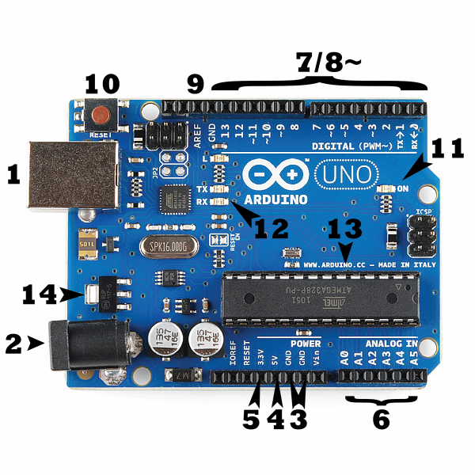
Arduino Uno
Power (USB / Barrel Jack)
Pins (5V, 3.3V, GND, Analog, Digital, PWM, AREF)
Reset Button
Power LED Indicator
TX RX LEDs
Main IC
Voltage Regulator

Slide 33
Now You have all the necessary knowledge to begin Programming the Arduino board.

Slide 34
Questions

